Slide 1
Ametryn Method CIPAC Collaborative Trial (5266/R) June 2021
William Meyerhoffer

Slide 2
Presentation Overview
General Information
Ametryn Method for TC; WG and SC formulations
Participants
Samples
Statistical Evaluation
Conclusion

Slide 3
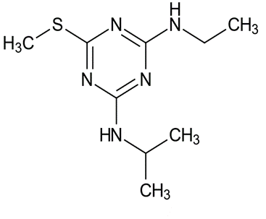
General Information
Ametryn
ISO common name: Ametryn
Chemical Name: 4-N-ethyl-6-methylsulfanyl-2-N-propan-2-yl-1,3,5-triazine-diamine
Molecular mass: 227.33 g/mole
Empirical formula: C₉H₁₇N₅S
Structure:
Method quantitates Ametryn in technical material (TC) and in associated formulations [water dispersible granules (WG); suspension concentrate (SC)]
Ametryn peak resolved from internal standard and any potential sample matrix interferences (impurities, formulation components) by use of suitable chromatographic conditions

Slide 4
General Information
Two TC’s and two formulation types (WG, SC) were analyzed for Ametryn content
Participants received samples and testing protocol including details on proposed gas chromatographic conditions and information on calculations and reporting of Study results
Any deviations from the proposed Ametryn method conditions were noted by the participating laboratories

Slide 5
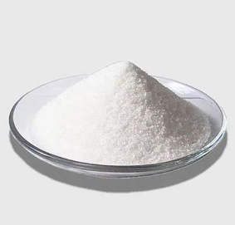
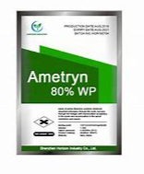
Determination of Ametryn in TC and WG, SC Formulations CIPAC Full Scale Collaborative Study (5266/R)

Slide 6
Outline of Ametryn Method
The sample containing Ametryn is dissolved in acetone containing an internal standard (dipropyl phthalate)
Sample solution is sonicated and then filtered (PTFE) into vials for analysis
The Ametryn concentration is determined by capillary gas chromatography using split injection and flame ionization detection with internal standard calibration
Results reported in g/kg to one decimal place

Slide 7
Proposed Ametryn Method Conditions
Capillary GC Column:
Fused silica, length 30 m x 0.25 mm internal diameter; DB-WAX or equivalent phase, with film thickness of 0.25 μm
(Crosslinked polyethylene glycol, high-polarity column).
Oven Temperature (Isothermal): 200°C
Injector Temperature: 275°C
Detector Temperature: 300°C
Flow : Helium 2.5 mL/min (Constant Flow)
Split: 40:1
Retention Times:
Ametryn: 17 min. approximately
Dipropyl Phthalate Internal Standard (IS): 5 min. approximately
RRT of Ametryn/Internal Standard: approximately 3.4

Slide 8
Method Calculations
Response factor RF
F_{C} = Peak area of the reference substance on the reference chromatogram W_{C} = Weight of the reference substance in mg, corrected for purity F_{CI} = Peak area of the internal standard on the reference chromatogram W_{CI} = Weight of the internal standard for the reference solution
Content (%); expressed in g/kg units for collaborative study
F_{S} = Peak area of the active ingredient on the test chromatogram W_{S} = Weight of the test substance F_{SI} = Peak area of the internal standard on the test chromatogram W_{SI} = Weight of the internal standard for the test solution

Slide 9
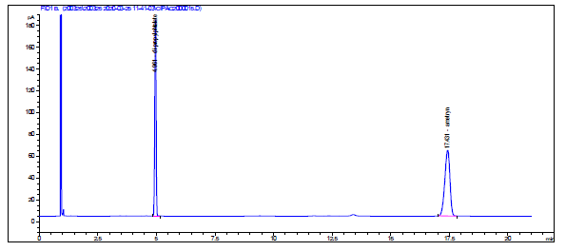
Example Chromatogram – TC DB-WAX Column (30 m x 0.25 mm, 0.25 µm)

Slide 10
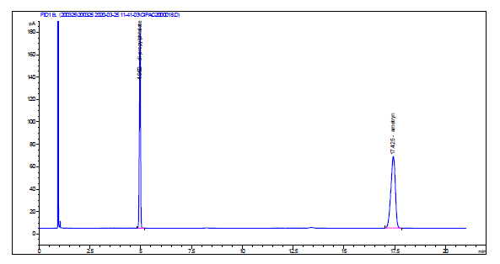
Example Chromatogram – WG Formulation DB-WAX Column (30 m x 0.25 mm, 0.25 µm)

Slide 11
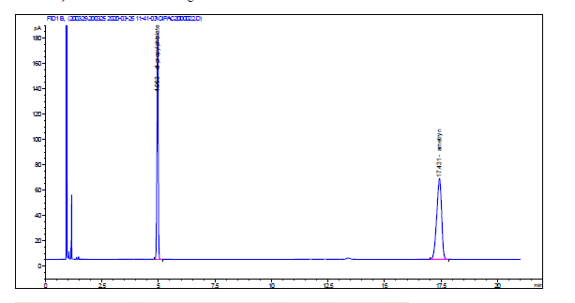
Example Chromatogram – SC Formulation DB-WAX Column (30 m x 0.25 mm, 0.25 µm)

Slide 12
Participants
Total of 19 respondents to CIPAC information sheet 325
Sample set was sent to all participants
15 laboratories participated in the collaborative trial
Participants were from Asia, Europe and South America
Belgium, China, Czech Republic, El Salvador, Germany, Greece, Hungary, India, Indonesia, Ireland, Romania, and Serbia

Slide 13
Samples
Ametryn Technical Material: TC Sample A
Ametryn Technical Material: TC Sample B
Ametryn Water Dispersible Granule: WG Sample C
Ametryn Suspension Concentrate: SC Sample D
Ametryn Suspension Concentrate: SC Sample E
Dipropyl Phthalate Internal Standard
Ametryn Reference Standard (983 g/kg)

Slide 14
Statistical Evaluation – Screening for Validity of Data
All method deviations, noted by the participants, were deemed not to affect the analytical results significantly
For all samples, graphs demonstrating
all data
outliers/stragglers
and…..
Summary of statistical evaluation
Including all data
Mandel’s h and k straggler and outliers removed
Notes:
Mandels test – inter-laboratory consistency: h → inter laboratory accuracy, k → within lab precision

Slide 15
Statistical Evaluation – Outliers/Stragglers
Ametryn TC – Sample A: 3 outliers detected
Mandel’s k-statistic outliers and h-statistic outlier (Laboratory 13)
R limits
r limits
Mean
Notes:
Straggler → 5% level, assumes Gaussian
Outlier → 1% level
R – reproducibility limit
r – repeatability limit
Error bars represent the two determinations on consecutive days

Slide 16
Statistical Evaluation – Outliers/Stragglers
Ametryn TC – Sample B: 3 outliers detected
Mandel’s k-statistic outliers and h-statistic outlier (Laboratory 13)
R limits
r limits
Mean

Slide 17
Statistical Evaluation – Outliers/Stragglers
Ametryn WG – Sample C: 2 stragglers and 1 outlier
Mandel’s k-statistic stragglers (Laboratory 6) and h-statistic outlier (Laboratory 13)
R limits
r limits
Mean

Slide 18
Statistical Evaluation – Outliers/Stragglers
Ametryn SC – Sample D: 3 outliers detected
Mandel’s k-statistic outliers (Laboratory 3) and h-statistic outlier (Laboratory 13)
R limits
r limits
Mean

Slide 19
Statistical Evaluation – Outliers/Stragglers
Ametryn SC – Sample E: 3 outliers detected
Mandel’s k-statistic outliers (Laboratory 3) and h-statistic outlier (Laboratory 13)
R limits
r limits
Mean

Slide 20
Summary of the Statistical Evaluation – No Elimination
Notes:
Key comparison is RSDR → relative reproducibility SD with RSDR(Hor) → relative reproducibility SD Horwitz calulation

Slide 21
Summary of the Statistical Evaluation – Elimination of Outliers and Stragglers

Slide 22
Summary
With the elimination of outliers and stragglers, the between laboratory experimental Relative Reproducibility Standard Deviation (% RSD_{R}) is within the acceptance limit based on the Horwitz curve calculation (% RSD_{R(Hor)}) for all samples tested (TC, WG and SC formulations)
% RSD_{R} < % RSD_{R(Hor)}

Slide 23
Conclusion
We consider the method 5265/m to be suitably validated
We recommend that method 5265/m is considered as a provisional CIPAC method

Slide 24
Special Thanks
To all laboratories and their staff participating in this collaborative trial and completing the study, given the challenging pandemic in 2020.
Dr. Pichen Hsu (Syngenta) for her assistance in the statistical analysis of all provided laboratory data.
Thank you

