Slide 1

Atrazine Method
CIPAC Collaborative Trial (5216/R)
Germany (June 2019)
William Meyerhoffer, Nancy Shi

Slide 2
Presentation Overview
General Information
Atrazine Method for TC; WG and SC formulations
Participants
Samples
Statistical Evaluation
Conclusion

Slide 3
General Information
Atrazine
ISO common name: Atrazine
Chemical Name: 2-chloro-4-ethylamino-6-isopropylamino-s-triazine
Molecular mass: 215.7 g/mole
Empirical formula: C₈H₁₄ClN₅
Structure:
Method quantitates Atrazine in technical material (TC) and in associated formulations [water dispersible granules (WG); suspension concentrate (SC)]
Atrazine peak resolved from internal standard and any potential sample matrix interferences (by-products, formulation components) by use of suitable chromatographic conditions

Slide 4
General Information
Two TC’s and two formulation types (WG, SC) were analyzed for Atrazine content
Participants received samples and testing protocol including details on proposed gas chromatographic conditions and information on calculations and reporting of Study results
Any deviations from the proposed Atrazine method conditions were noted by the participating laboratories

Slide 5
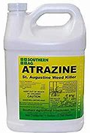
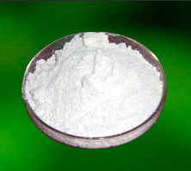
Determination of Atrazine in TC and WG, SC Formulations
CIPAC Full Scale Collaborative Study (5216/R)

Slide 6
Outline of Atrazine Method
The sample containing Atrazine is dissolved in acetone containing an internal standard (dipropyl phthalate)
Sample solution is sonicated and then filtered (PTFE) into vials for analysis
The Atrazine concentration is determined by capillary gas chromatography using split injection and flame ionization detection with internal standard calibration
Results reported in g/kg to one decimal place

Slide 7
Proposed Atrazine Method Conditions
Capillary GC Column:
Fused silica, length 15 m x 0.25 mm internal diameter; DB-225 or equivalent phase, with film thickness of 0.25 μm
(50% Cyanopropylphenyl/50% dimethylpolysiloxane).
Oven Temperature (Isothermal): 175°C
Flow : Hydrogen 2 mL/min
Contant Pressure Mode: 10 psi
Split: 50:1
Retention Times:
  Atrazine: 9 min. approximately
  Dipropyl Phthalate Internal Standard (IS): 6 min. approximately
  RRT of Atrazine/Internal Standard: approximately 1.5

Slide 8
Method Calculations
Response factor RF
F_{C} = Peak area of the reference substance on the reference chromatogram
W_{C} = Weight of the reference substance in mg, corrected for purity
F_{CI} = Peak area of the internal standard on the reference chromatogram
W_{CI} = Weight of the internal standard for the reference solution
Content (%); expressed in g/kg units for collaborative study
F_{S} = Peak area of the active ingredient on the test chromatogram
W_{S} = Weight of the test substance
F_{SI} = Peak area of the internal standard on the test chromatogram
W_{SI} = Weight of the internal standard for the test solution

Slide 9
Example Chromatogram – TC
DB-225 Column (15 m x 0.25 mm, 0.25 µm)

Slide 10
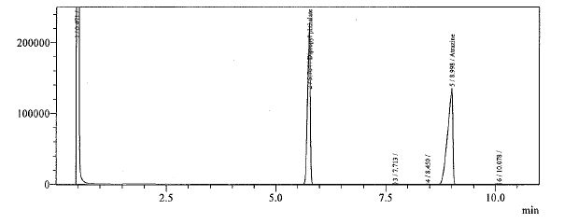
Example Chromatogram – WG Formulation
DB-225 Column (15 m x 0.25 mm, 0.25 µm)

Slide 11
Example Chromatogram – SC Formulation
DB-225 Column (15 m x 0.25 mm, 0.25 µm)

Slide 12
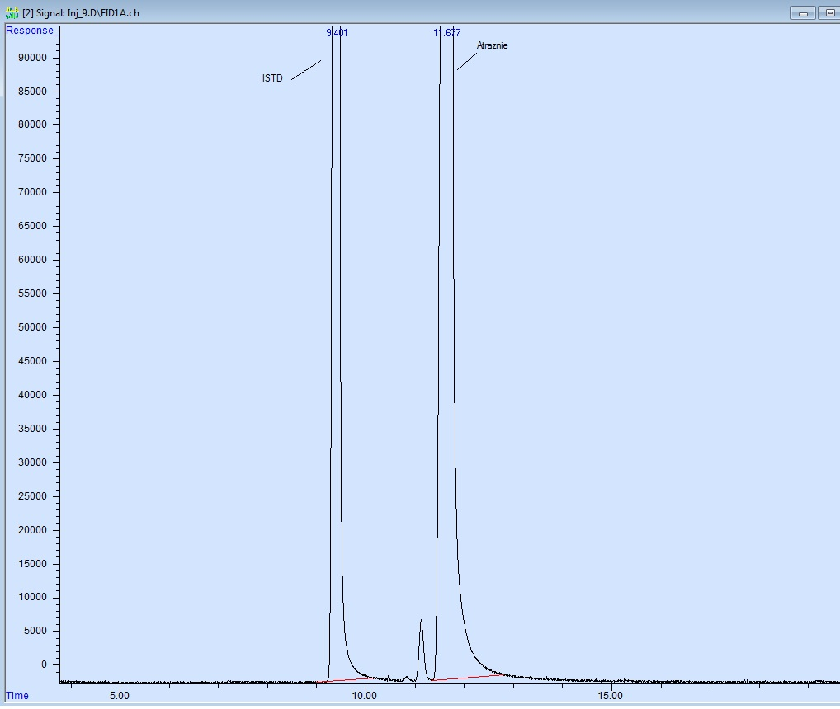
Example TC Chromatogram
DB-1701 Column (30 m x 0.25 mm, 0.25 µm)
Internal
Standard
Atrazine
Consideration of DB-1701 as a potential alternative capillary GC column??

Slide 13
Participants
Total of 20 respondents to CIPAC information sheet 318
  Sample set was sent to 16 participants
15 participants have sent back results in time
Participants were from Asia, Europe and the Americas
  Belgium, China, Germany, Greece, India, Ireland, Japan, Panama, Romania, Switzerland, Thailand, Uruguay and USA

Slide 14
Samples
Atrazine Technical Concentrate: TC Sample A
Atrazine Technical Concentrate: TC Sample B
Atrazine Water Dispersible Granule: WG Sample C
Atrazine Suspension Concentrate: SC Sample D
Atrazine Suspension Concentrate: SC Sample E
Dipropyl Phthalate Internal Standard
Atrazine Reference Standard (971 g/kg)

Slide 15
Statistical Evaluation – Screening for Validity of Data
All method deviations, noted by the participants, were deemed not to affect the analytical results significantly
For all samples, graphs demonstrating
  all data
  outliers/stragglers
and…..
Summary of statistical evaluation
  Including all data
  Mandel’s h and k straggler and outliers removed
Notes:
Mandels test – inter-laboratory consistency: h → inter laboratory accuracy, k → within lab precision

Slide 16
Statistical Evaluation – Outliers/Stragglers
Atrazine TC – Sample A: 2 outliers detected
Mandel’s k-statistic and h-statistic outliers (Laboratory 3)
R limits
r limits
Mean
Notes:
Straggler → 5% level, assumes Gaussian
Outlier → 1% level
R – reproducibility limit
r – repeatability limit
Error bars represent the two determinations on consecutive days

Slide 17
Statistical Evaluation – Outliers/Stragglers
Atrazine TC – Sample B: 2 outliers and 1 straggler detected
Mandel’s k-statistic outlier and h-statistic straggler (Laboratory 16)
R limits
r limits
Mean

Slide 18
Statistical Evaluation – Outliers/Stragglers
Atrazine WG – Sample C: 2 outliers detected
Mandel’s k-statistic and h-statistic outliers (Laboratory 3)
R limits
r limits
Mean

Slide 19
Statistical Evaluation – Outliers/Stragglers
Atrazine SC – Sample D: 2 stragglers detected
Mandel’s k-statistic stragglers (Laboratory 13)
R limits
r limits
Mean

Slide 20
Statistical Evaluation – Outliers/Stragglers
Atrazine SC – Sample E: No outliers or stragglers detected
R limits
r limits
Mean

Slide 21
Summary of the Statistical Evaluation – No Elimination
Experimental result
Acceptance criterion
Notes:
Key comparison is RSDR → relative reproducibility SD with RSDR(Hor) → relative reproducibility SD Horwitz calulation

Slide 22
Summary of the Statistical Evaluation – Elimination of Outliers and Stragglers
Experimental result
Acceptance criterion

Slide 23
Summary
With or without elimination of outliers or stragglers, the between laboratory experimental Relative Reproducibility Standard Deviation (% RSD_{R}) is within the acceptance limit based on the Horwitz curve calculation (% RSD_{R(Hor)}) for all samples tested (TC, WG and SC formulations)
% RSD_{R} < % RSD_{R(Hor)}

Slide 24
Conclusion
We consider the method 5215/m to be suitably validated
We recommend that method 5215/m is considered as a provisional CIPAC method with potential inclusion of DB-1701 capillary GC column as an alternative to the proposed DB-225 column

Slide 25
Special Thanks
To all laboratories and their staff participating in this collaborative trial and sending back the results in time……
Dr. Nancy Shi (Syngenta) for her assistance in the statistical analysis of all provided laboratory data.
Thank you

