Slide 1
Determination of the Relevant Impurity Toluene in Formulations by Headspace Gas Chromatography and Flame Ionisation or Mass Spectrometric Detection
CIPAC Collaborative Trial
Syngenta Crop Protection AG in collaboration with DAPA (German speaking working group for plant protection product analytics)
Robert Kettner

Slide 2
Purpose of the Method
In the EU, the content of Toluene as a relevant impurity is specified in several active ingredients (COMMISSION IMPLEMENTING REGULATION (EU) No 540/2011)
Examples: 0.5 g Toluene / kg Metazachlor,
2 g Toluene / kg Azoxystrobin,
5 g Toluene / kg Difenoconazole,
5 g Toluene / kg Prothioconazole;
Actual range 0.5 – 13 g Toluene / kg a.i.
The manufacturers of the ai and the formulations have to submit a validated analytical method for each formulation/ai to the registration authorithies
Goal: establish a method with universal applicability tested in a collaborative trial to determine the toluene content

Slide 3
Scope of Method
The content of toluene as relevant impurity of the active ingredient is determined at low levels in solid formulated products and in water and organic solvent based liquid formulated products.
The impurity toluene is measured in all different formulation types.
The active ingredient does not interfere for this method.

Slide 4
Principle of Method
The Toluene content of the samples is determined by headspace capillary gas chromatography (column with low-medium polarity stationary phase), helium carrier gas and flame ionisation or mass spectrometric detection.
Standard addition method for quantification to compensate for matrix effects.
Headspace instrumentation with an appropriate injection system - either a fixed transfer line to the GC or a gastight syringe (PAL-autosampler or equivalent).
Benefits of Headspace Injection Technique:
Only volatile components present in the sample get injected. Solids and high boiling liquids remain in the headspace vial and will not contaminate the GC column.

Slide 5
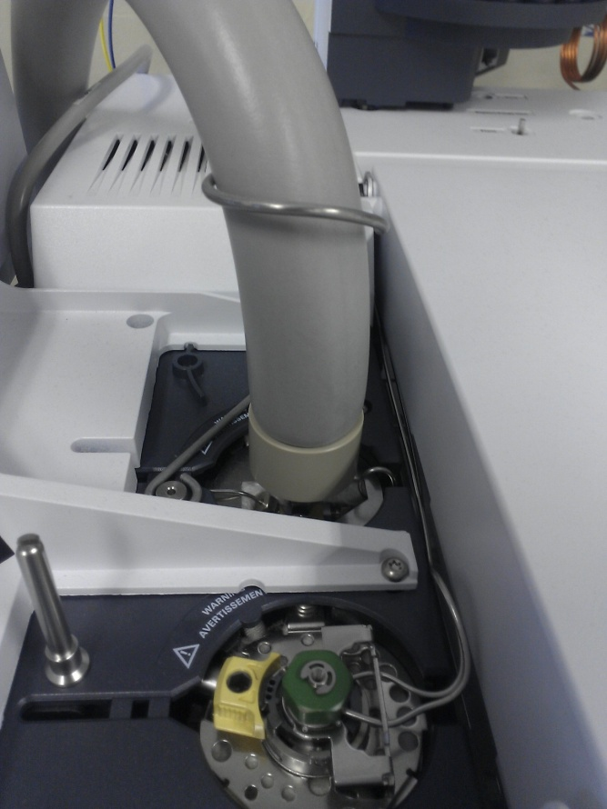
Headspace GC-FID
Autosampler Parameters, for fixed transfer line
Headspace Sampler: Agilent 7694E
Oven: 100 °C
Transfer Line: 200 °C
Equilibration time: 30 min
Pressurize time: 0.1 min
Pressure: 100 kPa
Loop fill time: 0.1 min
Loop equilibration time: 0.1 min
Injection time: 1 min
Loop injection volume: 1 ml
Shake: low

Slide 6
Headspace GC-FID
Chromatography Parameters
Gas Chromatograph: Agilent 6890A
Detector: FID
Column: J&W DB-624, 30 m, 0.32 mm i.d., 1,8 µm film
Column temperature: 50°C, hold 2 min,
50 –110°C heating rate 3°C/min,
110 – 240°C, heating rate 40°C/min, 2 min hold
Detector temperature: 300°C
Injector temperature: 220°C
Split ratio: 20:1
Carrier gas: Helium, 2.0 ml / minute (constant flow)
Make-up gas: Nitrogen, 30 ml / minute

Slide 7
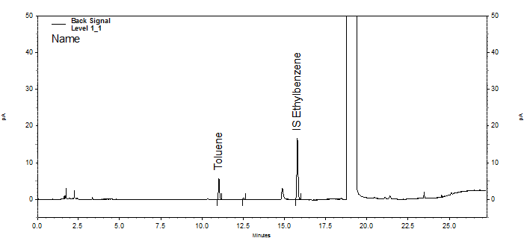
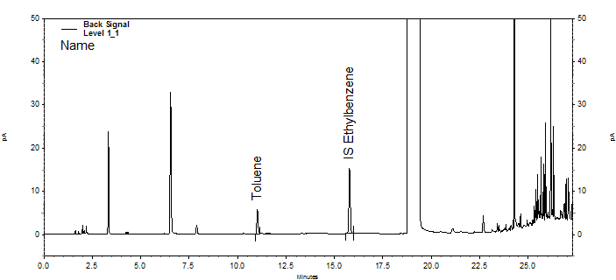
Chromatograms Headspace GC-FID
SC-formulation
(Level 1)
EC-formulation
(Level 1)

Slide 8
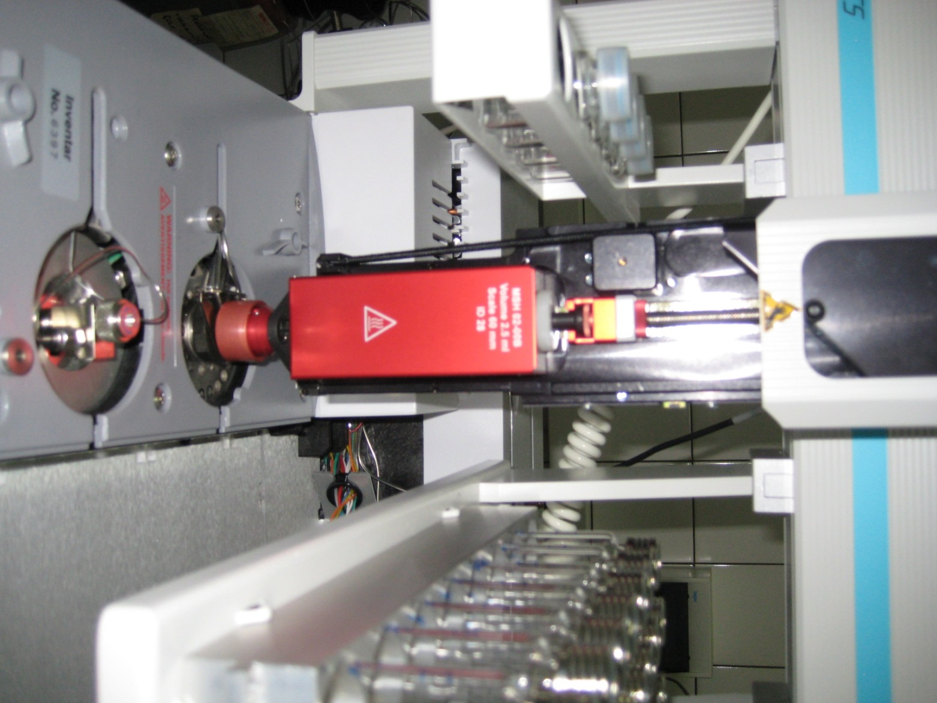
PAL-Autosampler Parameters
Gastight Syringe
Incubation Temperature (°C) 100
Incubation Time (s) 1800
Syringe Temperature (°C) 110
Agitator Speed (rpm) 500
Fill Speed (ul/s) 100
Fill Strokes 0
Pullup Delay (ms) 6000
Injection Speed (ul/s) 500
Pre Inject Delay (ms) 500
Post Inject Delay (ms) 500
Flush Time (s) 90

Slide 9
GC-MS Parameter and Method Modifications
SIM-mode at m/z 91 for toluene and ethylbenzene and at m/z 98 for D8-Toluene
Full SCAN (e.g. m/z 30 – 260) with quantification at m/z 91 for toluene and ethylbenzene and at m/z 98 for D8-toluene
Standard instrument parameters that are appropriate for the mass spectrometer instrument used
Modifications:
Adaptions of split ratio and/or injection volume
DB-624 column can be replaced by a 5 % phenyl column (e.g. RTX-5, DB-5) when using MS-detection
Deuterated Toluene instead of ethylbenzene as internal standard (MS)

Slide 10
Chromatograms Headspace GC-MS
SC-formulation
(Level 1)
EC-formulation
(Level 1)
SIM m/z 91
Toluene
Ethylbenzene
SIM m/z 91
Toluene
Ethylbenzene

Slide 11
Sample Preparation
Reference substance: Toluene of known content
Internal standard (IS): Ethylbenzene
Solvent: Dimethylsulfoxide (DMSO), Headspace Quality
Sample weight: Sufficient amount of sample to contain 20 mg of active ingredient of interest. Total volume: 4 ml

Slide 12
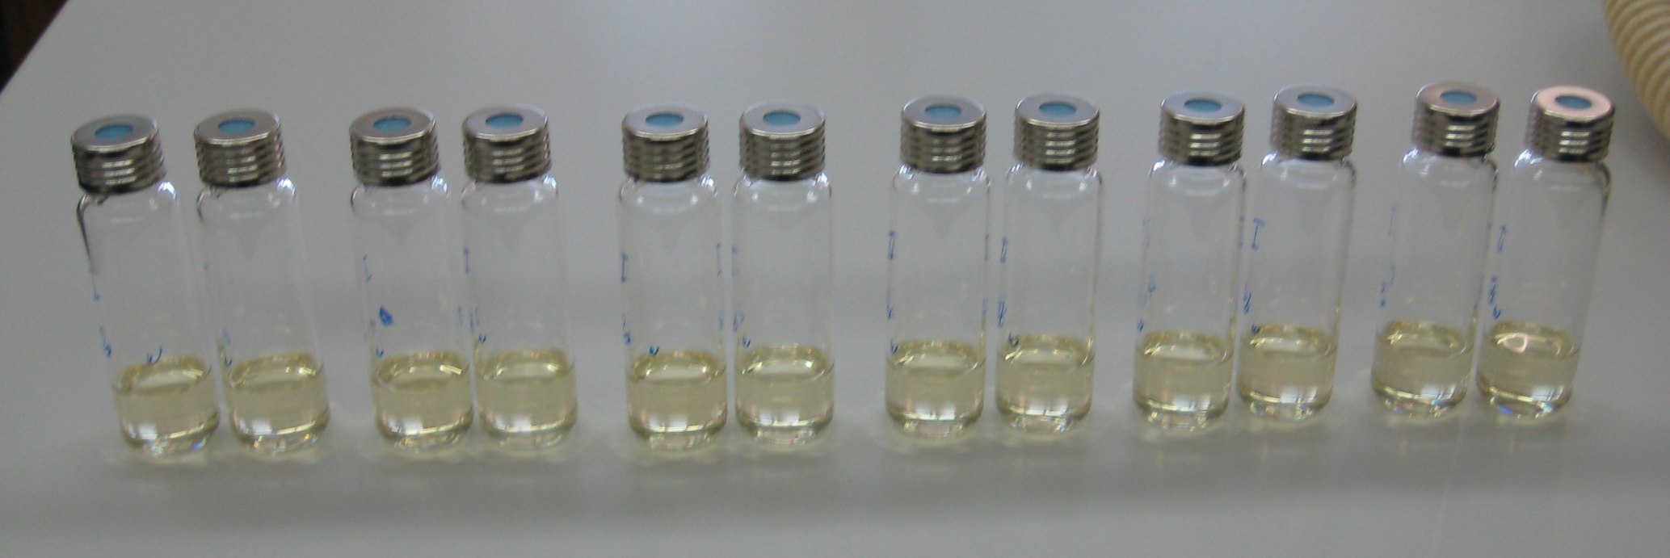
Description of sample preparation
Level 0 no Toluene added, only internal standard (Ethylbenzene)
Level 1 2.5 µg Toluene / ml = 0.05% Toluene in relation to AI
Level 2 5 µg Toluene / ml = 0.10% Toluene in relation to AI
Level 3 12.5 µg Toluene / ml = 0.25% Toluene in relation to AI
Level 4 25 µg Toluene / ml = 0.50% Toluene in relation to AI
Level 5 50 µg Toluene / ml = 1.00% Toluene in relation to AI
Sample weight: Sufficient amount of sample to contain 20 mg of active ingredient of interest. Total volume: 4 ml
Level 0
Level 1
Level 2
Level 3
Level 4
Level 5

Slide 13
Participating Laboratories
Country | Name | Organisation
Switzerland | R. Kettner | Syngenta Crop Protection AG
Switzerland | U. Schaller | Agroscope
Germany | T. Bowen | Bayer Crop Science AG
Germany | P. Wagener | Bayer Crop Science AG
Germany | M. Haustein | Currenta GmbH & Co. OHG
Austria | C. Czerwenka | Austrian Agency for Health and Food Safety
Netherlands | M. Bos | Cerexagri BV
Denmark | E. Jacobsen | Danish Technological Institute
Czech Rep. | O. Novakova | Central Institute for Supervising and Testing in Agriculture, National Reference Lab.
Belgium | O. Pigeon | Wallon Agricultural Research Centre
India | S. Khot | Syngenta Bioscience Pvt. Ltd.
China | R. Joseph | Jiangsu Rotam Chemistry
China | Y. Wang | Nutrichem Laboratory Co Ltd.

Slide 14
Comments from the Labs
Lab 4: Nitrogen instead of helium used as carrier gas. Recommendation to
extend the time of the temperature programme (formulation EC2)
Lab 5: Injection volume 500 µl instead of 1000 µl; chromatography shortened due to MS detection, toluene-d8 used as internal standard.
MS detection in SIM mode: ions for toluene m/z = 91 (quantifier), 92 (qualifier 1), 65 (qualifier 2), ions for toluene-d8 m/z = 98.
The data were also evaluated by external calibration (using the internal standard D₈-toluene). The obtained results were comparable to those obtained by standard addition.
Column: DB5, 30 m, 0.32 mm, film thickness 0.25 µm
Temp. program: 40°C for 7 min, 55°C/min ramp to 240°C, hold for 2 min.
Detector temp.: 220°C
Lab 6: Column: ZB-624, 60 m, 0.32 mm, film thickness 1.8 µm; Split ratio: 15:1
Lab 8: Carrier gas: hydrogen, shaking time: 12 s, split ratio 5:1
Lab 9: Analysis also performed with MS detection

Slide 15
Comments from the Labs
Lab 10: Column: BGB 5, 30 m, 0.32 mm, film thickness 0.25 µm
Temp. program: 50°C for 2 min, 3°C/min to 62°C, 40°C/min to 240°C, hold for 2 min.
Detector temp.: 230°C
Split ratio: 50:1
Lab 12: Column: DB-624, 30 m, 0.25 mm, film thickness 1.4 µm
Lab 13: Hold time of final column temperature increased to 5 min.

Slide 16
Test Items
Formulation Type | AI with Toluene
EC 250 | 25 % w/w
EC 400 | 18.2 % w/w ( total 2 ai)
FS 480 | 41.5 % w/w
SC 250 | 22.9 % w/w
WG 50 | 50 % w/w

Slide 17
Techniques applied for toluene determination
Autosampler |  | Detector
Fixed transfer line | Gastight syringe | FID | MS
5 labs | 8 labs | 9 labs | 4 labs

Slide 18
Results of a FS-Formulation
Weight Toluene Ref Std |  |  |  | 100 | mg
Purity Toluene |  |  |  | 99.9 | %
Content of AI of interest in the formulation |  |  |  | 41.50 | % w/w
Level | Toluol added [mg] | Toluene added | Sample | Area Toluene | Area IS | Ratio Toluene/IS | Ratio Toluene/IS corr. | Ratio Toluene/IS | Recovery [%]
 |  | relative to AI [%] | weight [mg] |  |  | found | found corr. | calculated
L_{0_1} | 0.000000 | 0.00 | 49.1 | 11.802 | 91.167 | 0.12945 | -0.00040 | 0.00200
L_{0_2} | 0.000000 | 0.00 | 52.1 | 12.436 | 89.989 | 0.13819 | 0.00040 | 0.00200
L_{1_1} | 0.009990 | 0.05 | 53.8 | 25.584 | 86.487 | 0.29581 | 0.15353 | 0.15168 | 101.2
L_{1_1} | 0.009990 | 0.05 | 49.3 | 24.289 | 86.526 | 0.28071 | 0.15033 | 0.15168 | 99.1
L_{2_1} | 0.019980 | 0.10 | 51.3 | 38.355 | 86.881 | 0.44147 | 0.30580 | 0.30136 | 101.5
L_{2_2} | 0.019980 | 0.10 | 52.4 | 39.01 | 88.322 | 0.44168 | 0.30310 | 0.30136 | 100.6
L_{3_1} | 0.049950 | 0.24 | 49.9 | 77.471 | 88.326 | 0.87710 | 0.74513 | 0.75040 | 99.3
L_{3_2} | 0.049950 | 0.24 | 51.7 | 78.141 | 88.62 | 0.88175 | 0.74502 | 0.75040 | 99.3
L_{4_1} | 0.099900 | 0.48 | 53.7 | 143.598 | 87.318 | 1.64454 | 1.50252 | 1.49880 | 100.2
L_{4_2} | 0.099900 | 0.48 | 49.5 | 142.555 | 87.24 | 1.63406 | 1.50315 | 1.49880 | 100.3
L_{5_1} | 0.199800 | 0.95 | 49.7 | 272.636 | 87.085 | 3.13069 | 2.99925 | 2.99560 | 100.1
L_{5_2} | 0.199800 | 0.95 | 52.3 | 273.461 | 87.437 | 3.12752 | 2.98920 | 2.99560 | 99.8
Average weight level 0 |  |  |  | 50.6 | mg | Average recovery level 1 |  |  | 100.2 | %
Average ratio level 0 |  |  |  | 0.13382 |  | Average recovery level 3 |  |  | 99.3 | %
 |  |  |  |  |  | Average recovery level 5 |  |  | 100.0 | %
Average ratio per mg sample weight |  |  |  | 0.002644664
Slope |  |  |  | 14.983
Intercept |  |  |  | 0.002
Correlation Coeff |  |  |  | 1.0000
Amount Toluene in solution |  |  |  | 0.00880 | mg
Amount Toluene relativ to formulation |  |  |  | 0.01739 | %
Amount Toluene relativ to AI |  |  |  | 0.042 | %
Toluene added [mg]
Linearity and Recovery established

Slide 19
Statistical evaluation – no elimination of stragglers/outliers
 | EC1 | EC2 | FS3 | SC4 | WG5
X_{m} [g/kg | 0.453 | 0.083 | 0.183 | 0.097 | 0.214
L | 13 | 13 | 13 | 13 | 13
S_{r} | 0.0264 | 0.0037 | 0.0110 | 0.0053 | 0.0027
S_{L} | 0.0569 | 0.0082 | 0.0139 | 0.0112 | 0.0161
S_{R} | 0.0628 | 0.0090 | 0.0177 | 0.0124 | 0.0163
r | 0.0738 | 0.0103 | 0.0309 | 0.0147 | 0.0076
R | 0.1752 | 0.0251 | 0.0497 | 0.0346 | 0.0458
RSD_{r} | 5.83 | 4.44 | 6.03 | 5.40 | 1.26
RSD_{R} | 13.87 | 10.83 | 9.68 | 12.71 | 7.65
RSD_{R}(Hor) | 6.38 | 8.23 | 7.30 | 8.03 | 7.14

Slide 20
Statistical evaluation – with elimination of stragglers/outliers
 | EC1 | EC2 | FS3 | SC4 | WG5
X_{m} [g/kg] | 0.480 | 0.083 | 0.180 | 0.092 | 0.211
L | 10 | 11 | 10 | 10 | 11
S_{r} | 0.0211 | 0.0026 | 0.0063 | 0.0038 | 0.0074
S_{L} | 0.0265 | 0.0079 | 0.0117 | 0.0063 | 0.0129
S_{R} | 0.0339 | 0.0083 | 0.0133 | 0.0074 | 0.0149
r | 0.0591 | 0.0074 | 0.0176 | 0.0107 | 0.0206
R | 0.0950 | 0.0234 | 0.0372 | 0.0207 | 0.0416
RSD_{r} | 4.39 | 3.17 | 3.49 | 4.15 | 3.49
RSD_{R} | 7.06 | 10.07 | 7.38 | 8.00 | 7.05
RSD_{R}(Hor) | 6.32 | 8.23 | 7.32 | 8.10 | 7.15

Slide 21
Statistical evaluation – Straggler/Outlier detection
R limits
r limits
Mean
Labs 10,12:
Mandels h-statistic straggler
Lab 7:
Mandels k-statistic straggler

Slide 22
Statistical evaluation – Straggler/Outlier detection
R limits
r limits
Mean
Labs 6,12:
Mandels k-statistic straggler

Slide 23
Statistical evaluation – Straggler/Outlier detection
R limits
r limits
Mean
Labs 5,9,12:
Mandels k-statistic straggler

Slide 24
Statistical evaluation – Straggler/Outlier detection
Labs 9,13:
Mandels h-statistic straggler
R limits
r limits
Mean
Lab12:
Mandels k-statistic outlier

Slide 25
Statistical evaluation – Straggler/Outlier detection
Labs 9,13:
Mandels h-statistic straggler
R limits
r limits
Mean
Lab 6:
Mandels k-statistic straggler

Slide 26
Conclusion
% RSD_{R} meets the calculated acceptable value (% RSD_{R (Hor)}) based on the Horwitz equation after elimination of stragglers/ outlieres for FS, SC and WG formulations.
% RSD_{R} for both EC-formulations tested is slightly above the Horwitz value after elimination of stragglers/outlieres.
Nevertheless this does not affect the validity of the results or the
suitability of the analytical method.
Due to the universal applicability of the method (all formulation types), the Headspace-technique using different sampling devices (fixed transfer line or gastight syringe) and different detectors used (FID or MS) a slightly higher coefficient of variation in this collaborative trial is acceptable.

Slide 27
Conclusion
Based on the results of this CIPAC Collaborative Study we consider this method to be fit for use and recommend accepting it as a provisional CIPAC MT-method for the determination of toluene as relevant impurity of the active ingredient at low levels in solid formulated products and in water and organic solvent based liquid formulated products.

